Slide 1
Foundations of Cryptography garbled circuit, delegating computation, homomorphic encryption, Paillier’s encryption
LiangFeng Zhang
zhanglf@shanghaitech.edu.cn
SIST, ShanghaiTech, 2019F

Slide 2



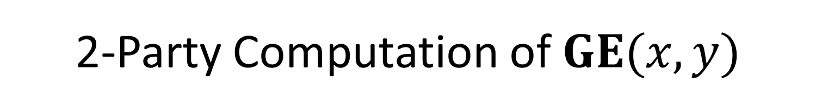













2-Party Computation of $GE(x,y)$
$$(k_{2}^{0},k_{2}^{1})$$
$$(k_{4}^{0},k_{4}^{1})$$
$$(k_{6}^{0},k_{6}^{1})$$
$$(k_{1}^{0},k_{1}^{1})$$
$$(k_{3}^{0},k_{3}^{1})$$
$$(k_{5}^{0},k_{5}^{1})$$
$$(k_{8}^{0},k_{8}^{1})$$
$$(k_{9}^{0},k_{9}^{1})$$
$$(k_{7}^{0},k_{7}^{1})$$
$$(k_{10}^{0},k_{10}^{1})$$
$$(k_{11}^{0},k_{11}^{1})$$
$$(k_{12}^{0},k_{12}^{1})$$
$$(k_{13}^{0},k_{13}^{1})$$
The output wire of each gate is encrypted by its left input wire and then by its right input wire.
$$(k_{14}^{0},k_{14}^{1})$$
$$(k_{15}^{0},k_{15}^{1})$$
$$(k_{16}^{0},k_{16}^{1})$$

Slide 3






2-Party Computation of $GE(x,y)$
$$(k_{2}^{0},k_{2}^{1})$$
$$(k_{4}^{0},k_{4}^{1})$$
$$(k_{6}^{0},k_{6}^{1})$$
$$(k_{1}^{0},k_{1}^{1})$$
$$(k_{3}^{0},k_{3}^{1})$$
$$(k_{5}^{0},k_{5}^{1})$$
$$(k_{8}^{0},k_{8}^{1})$$
$$(k_{9}^{0},k_{9}^{1})$$
$$(k_{7}^{0},k_{7}^{1})$$
$$(k_{10}^{0},k_{10}^{1})$$
$$(k_{11}^{0},k_{11}^{1})$$
$$(k_{12}^{0},k_{12}^{1})$$
$$(k_{13}^{0},k_{13}^{1})$$
$$(k_{14}^{0},k_{14}^{1})$$
$$(k_{15}^{0},k_{15}^{1})$$
$$(k_{16}^{0},k_{16}^{1})$$

Slide 4

2-Party Computation of $GE(x,y)$
$$(k_{2}^{0},k_{2}^{1})$$
$$(k_{4}^{0},k_{4}^{1})$$
$$(k_{6}^{0},k_{6}^{1})$$
$$(k_{1}^{0},k_{1}^{1})$$
$$(k_{3}^{0},k_{3}^{1})$$
$$(k_{5}^{0},k_{5}^{1})$$
$$(k_{8}^{0},k_{8}^{1})$$
$$(k_{9}^{0},k_{9}^{1})$$
$$(k_{7}^{0},k_{7}^{1})$$
$$(k_{10}^{0},k_{10}^{1})$$
$$(k_{11}^{0},k_{11}^{1})$$
$$(k_{12}^{0},k_{12}^{1})$$
$$(k_{13}^{0},k_{13}^{1})$$
$$(k_{14}^{0},k_{14}^{1})$$
$$(k_{15}^{0},k_{15}^{1})$$
$$(k_{16}^{0},k_{16}^{1})$$

Slide 5

2-Party Computation of $GE(x,y)$
$$(k_{2}^{0},k_{2}^{1})$$
$$(k_{4}^{0},k_{4}^{1})$$
$$(k_{6}^{0},k_{6}^{1})$$
$$(k_{1}^{0},k_{1}^{1})$$
$$(k_{3}^{0},k_{3}^{1})$$
$$(k_{5}^{0},k_{5}^{1})$$
$$(k_{8}^{0},k_{8}^{1})$$
$$(k_{9}^{0},k_{9}^{1})$$
$$(k_{7}^{0},k_{7}^{1})$$
$$(k_{10}^{0},k_{10}^{1})$$
$$(k_{11}^{0},k_{11}^{1})$$
$$(k_{12}^{0},k_{12}^{1})$$
$$(k_{13}^{0},k_{13}^{1})$$
$$(k_{14}^{0},k_{14}^{1})$$
$$(k_{15}^{0},k_{15}^{1})$$
$$(k_{16}^{0},k_{16}^{1})$$

Slide 6

2-Party Computation of $GE(x,y)$
$$(k_{2}^{0},k_{2}^{1})$$
$$(k_{4}^{0},k_{4}^{1})$$
$$(k_{6}^{0},k_{6}^{1})$$
$$(k_{1}^{0},k_{1}^{1})$$
$$(k_{3}^{0},k_{3}^{1})$$
$$(k_{5}^{0},k_{5}^{1})$$
$$(k_{8}^{0},k_{8}^{1})$$
$$(k_{9}^{0},k_{9}^{1})$$
$$(k_{7}^{0},k_{7}^{1})$$
$$(k_{10}^{0},k_{10}^{1})$$
$$(k_{11}^{0},k_{11}^{1})$$
$$(k_{12}^{0},k_{12}^{1})$$
$$(k_{13}^{0},k_{13}^{1})$$
$$(k_{14}^{0},k_{14}^{1})$$
$$(k_{15}^{0},k_{15}^{1})$$
$$(k_{16}^{0},k_{16}^{1})$$

Slide 7

2-Party Computation of $GE(x,y)$
$$(k_{2}^{0},k_{2}^{1})$$
$$(k_{4}^{0},k_{4}^{1})$$
$$(k_{6}^{0},k_{6}^{1})$$
$$(k_{1}^{0},k_{1}^{1})$$
$$(k_{3}^{0},k_{3}^{1})$$
$$(k_{5}^{0},k_{5}^{1})$$
$$(k_{8}^{0},k_{8}^{1})$$
$$(k_{9}^{0},k_{9}^{1})$$
$$(k_{7}^{0},k_{7}^{1})$$
$$(k_{10}^{0},k_{10}^{1})$$
$$(k_{11}^{0},k_{11}^{1})$$
$$(k_{12}^{0},k_{12}^{1})$$
$$(k_{13}^{0},k_{13}^{1})$$
$$(k_{14}^{0},k_{14}^{1})$$
$$(k_{15}^{0},k_{15}^{1})$$
$$(k_{16}^{0},k_{16}^{1})$$

Slide 8

2-Party Computation of $GE(x,y)$
$$(k_{2}^{0},k_{2}^{1})$$
$$(k_{4}^{0},k_{4}^{1})$$
$$(k_{6}^{0},k_{6}^{1})$$
$$(k_{1}^{0},k_{1}^{1})$$
$$(k_{3}^{0},k_{3}^{1})$$
$$(k_{5}^{0},k_{5}^{1})$$
$$(k_{8}^{0},k_{8}^{1})$$
$$(k_{9}^{0},k_{9}^{1})$$
$$(k_{7}^{0},k_{7}^{1})$$
$$(k_{10}^{0},k_{10}^{1})$$
$$(k_{11}^{0},k_{11}^{1})$$
$$(k_{12}^{0},k_{12}^{1})$$
$$(k_{13}^{0},k_{13}^{1})$$
$$(k_{14}^{0},k_{14}^{1})$$
$$(k_{15}^{0},k_{15}^{1})$$
$$(k_{16}^{0},k_{16}^{1})$$

Slide 9

2-Party Computation of $GE(x,y)$
$$(k_{2}^{0},k_{2}^{1})$$
$$(k_{4}^{0},k_{4}^{1})$$
$$(k_{6}^{0},k_{6}^{1})$$
$$(k_{1}^{0},k_{1}^{1})$$
$$(k_{3}^{0},k_{3}^{1})$$
$$(k_{5}^{0},k_{5}^{1})$$
$$(k_{8}^{0},k_{8}^{1})$$
$$(k_{9}^{0},k_{9}^{1})$$
$$(k_{7}^{0},k_{7}^{1})$$
$$(k_{10}^{0},k_{10}^{1})$$
$$(k_{11}^{0},k_{11}^{1})$$
$$(k_{12}^{0},k_{12}^{1})$$
$$(k_{13}^{0},k_{13}^{1})$$
$$(k_{14}^{0},k_{14}^{1})$$
$$(k_{15}^{0},k_{15}^{1})$$
$$(k_{16}^{0},k_{16}^{1})$$

Slide 10

2-Party Computation of $GE(x,y)$
$$(k_{2}^{0},k_{2}^{1})$$
$$(k_{4}^{0},k_{4}^{1})$$
$$(k_{6}^{0},k_{6}^{1})$$
$$(k_{1}^{0},k_{1}^{1})$$
$$(k_{3}^{0},k_{3}^{1})$$
$$(k_{5}^{0},k_{5}^{1})$$
$$(k_{8}^{0},k_{8}^{1})$$
$$(k_{9}^{0},k_{9}^{1})$$
$$(k_{7}^{0},k_{7}^{1})$$
$$(k_{10}^{0},k_{10}^{1})$$
$$(k_{11}^{0},k_{11}^{1})$$
$$(k_{12}^{0},k_{12}^{1})$$
$$(k_{13}^{0},k_{13}^{1})$$
$$(k_{14}^{0},k_{14}^{1})$$
$$(k_{15}^{0},k_{15}^{1})$$
$$(k_{16}^{0},k_{16}^{1})$$

Slide 11

2-Party Computation of $GE(x,y)$
$$(k_{2}^{0},k_{2}^{1})$$
$$(k_{4}^{0},k_{4}^{1})$$
$$(k_{6}^{0},k_{6}^{1})$$
$$(k_{1}^{0},k_{1}^{1})$$
$$(k_{3}^{0},k_{3}^{1})$$
$$(k_{5}^{0},k_{5}^{1})$$
$$(k_{8}^{0},k_{8}^{1})$$
$$(k_{9}^{0},k_{9}^{1})$$
$$(k_{7}^{0},k_{7}^{1})$$
$$(k_{10}^{0},k_{10}^{1})$$
$$(k_{11}^{0},k_{11}^{1})$$
$$(k_{12}^{0},k_{12}^{1})$$
$$(k_{13}^{0},k_{13}^{1})$$
$$(k_{14}^{0},k_{14}^{1})$$
$$(k_{15}^{0},k_{15}^{1})$$
$$(k_{16}^{0},k_{16}^{1})$$

Slide 12

2-Party Computation of $GE(x,y)$
$$(k_{2}^{0},k_{2}^{1})$$
$$(k_{4}^{0},k_{4}^{1})$$
$$(k_{6}^{0},k_{6}^{1})$$
$$(k_{1}^{0},k_{1}^{1})$$
$$(k_{3}^{0},k_{3}^{1})$$
$$(k_{5}^{0},k_{5}^{1})$$
$$(k_{8}^{0},k_{8}^{1})$$
$$(k_{9}^{0},k_{9}^{1})$$
$$(k_{7}^{0},k_{7}^{1})$$
$$(k_{10}^{0},k_{10}^{1})$$
$$(k_{11}^{0},k_{11}^{1})$$
$$(k_{12}^{0},k_{12}^{1})$$
$$(k_{13}^{0},k_{13}^{1})$$
$$(k_{14}^{0},k_{14}^{1})$$
$$(k_{15}^{0},k_{15}^{1})$$
$$(k_{16}^{0},k_{16}^{1})$$

Slide 13

2-Party Computation of $GE(x,y)$
$$(k_{2}^{0},k_{2}^{1})$$
$$(k_{4}^{0},k_{4}^{1})$$
$$(k_{6}^{0},k_{6}^{1})$$
$$(k_{1}^{0},k_{1}^{1})$$
$$(k_{3}^{0},k_{3}^{1})$$
$$(k_{5}^{0},k_{5}^{1})$$
$$(k_{8}^{0},k_{8}^{1})$$
$$(k_{9}^{0},k_{9}^{1})$$
$$(k_{7}^{0},k_{7}^{1})$$
$$(k_{10}^{0},k_{10}^{1})$$
$$(k_{11}^{0},k_{11}^{1})$$
$$(k_{12}^{0},k_{12}^{1})$$
$$(k_{13}^{0},k_{13}^{1})$$
$$(k_{14}^{0},k_{14}^{1})$$
$$(k_{15}^{0},k_{15}^{1})$$
$$(k_{16}^{0},k_{16}^{1})$$

Slide 15



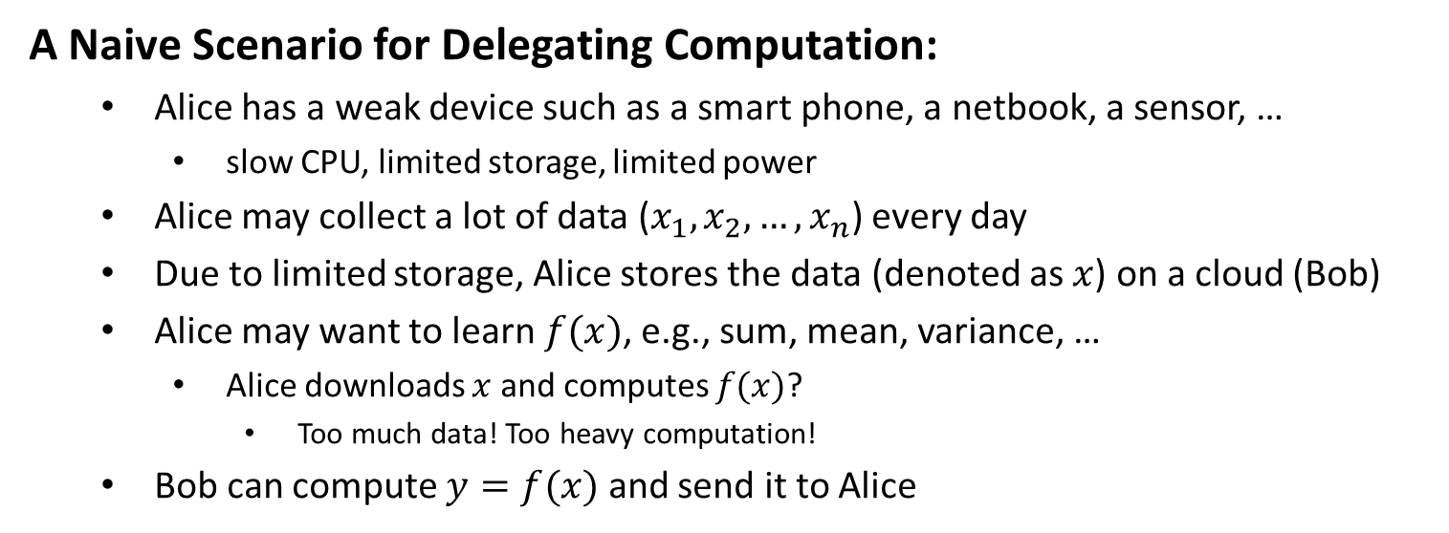



Delegating Computation
$x, f, f(x)$are all disclosed to Bob!
$$x=(x_{1},x_{2},…,x_{n})$$
$$f$$
$$y=f(x)$$
Alice
Bob
A Naive Scenario for Delegating Computation:
Alice has a weak device such as a smart phone, a netbook, a sensor, …
slow CPU, limited storage, limited power
Alice may collect a lot of data ($x_{1},x_{2},…,x_{n}$) every day
Due to limited storage, Alice stores the data (denoted as $x$) on a cloud (Bob)
Alice may want to learn $f(x)$, e.g., sum, mean, variance, …
Alice downloads $x$ and computes $f(x)$?
Too much data! Too heavy computation!
Bob can compute $y=f(x)$ and send it to Alice

Slide 16
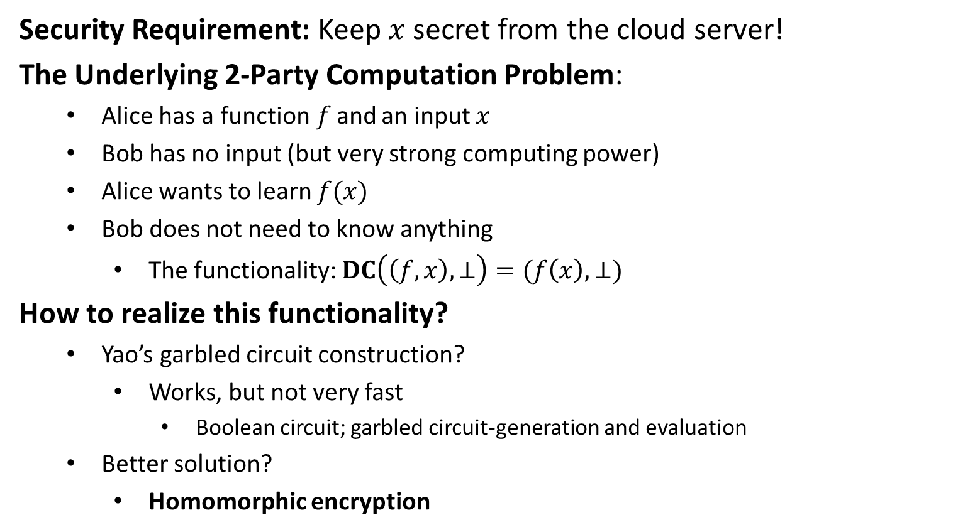
Delegating Computation
Security Requirement: Keep $x$ secret from the cloud server!
The Underlying 2-Party Computation Problem:
Alice has a function$f$and an input $x$
Bob has no input (but very strong computing power)
Alice wants to learn $f(x)$
Bob does not need to know anything
The functionality: $DC\left(\left(f,x\right), ⊥\right)=(f\left(x\right), ⊥)$
How to realize this functionality?
Yao’s garbled circuit construction?
Works, but not very fast
Boolean circuit; garbled circuit-generation and evaluation
Better solution?
Homomorphic encryption

Slide 17






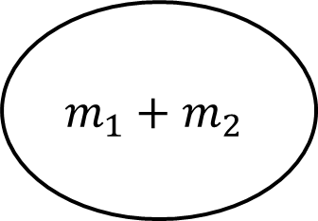
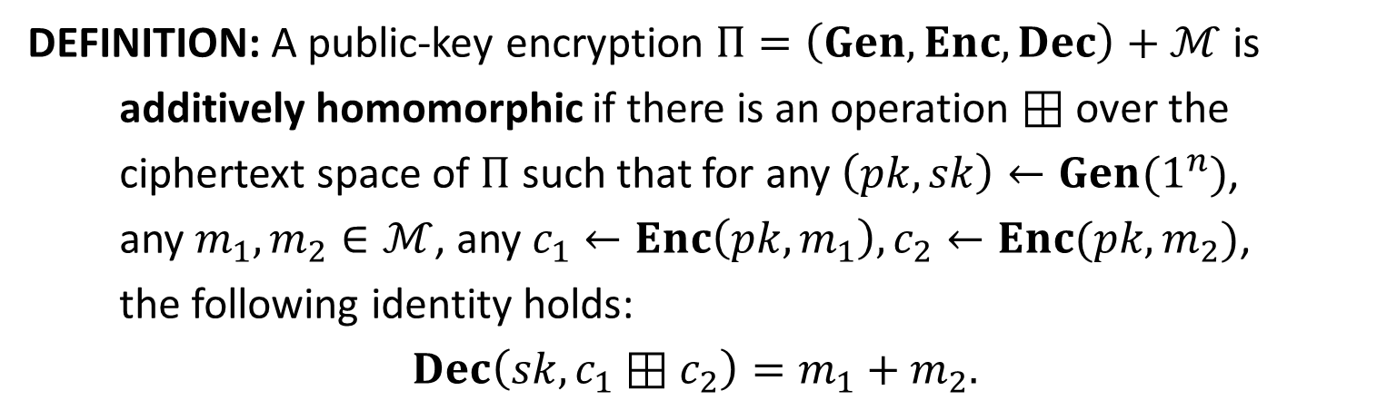





Homomorphic Encryption
DEFINITION: A public-key encryption $Π=\left(Gen,Enc,Dec\right)+ℳ$ is
additively homomorphic if there is an operation $⊞$ over the
ciphertext space of $Π$ such that for any $\left(pk,sk\right)←Gen(1^{n})$,
any $m_{1},m_{2}∈ℳ$, any $c_{1}←Enc\left(pk,m_{1}\right), c_{2}←Enc(pk,m_{2})$,
the following identity holds:
$$Dec\left(sk, c_{1}⊞c_{2}\right)=m_{1}+m_{2}.$$
$$c_{1}$$
$$m_{1}$$
$$m_{1}$$
$$m_{1}+m_{2}$$
$$Dec$$
$$Enc$$
$$⊞$$
$$m_{1}+m_{2}$$
$$m_{2}$$
$$m_{2}$$
$$c_{2}$$
$$c_{1}⊞c_{2}$$

Slide 19
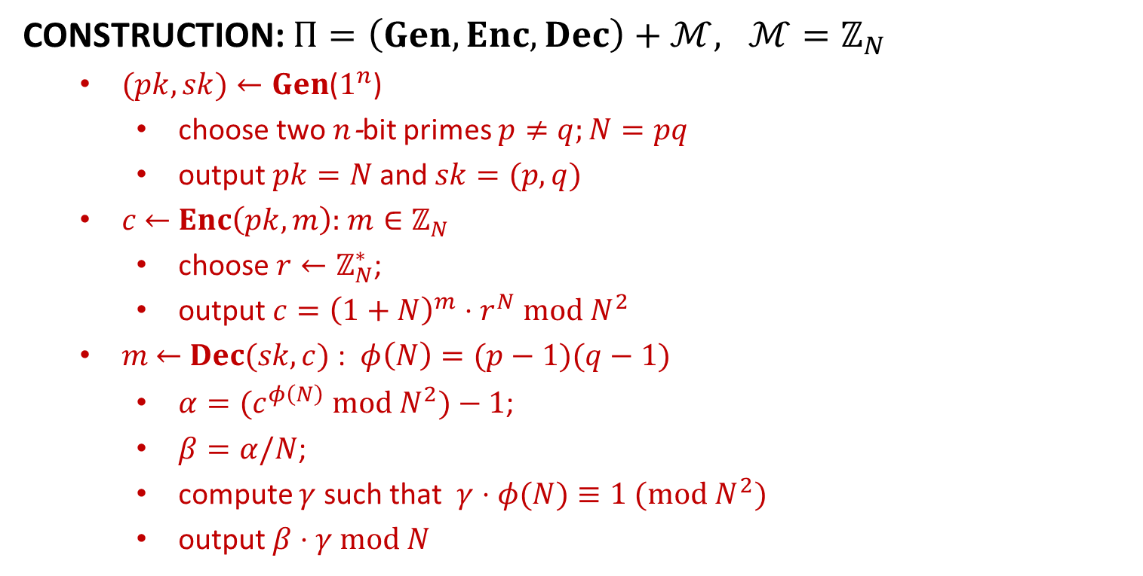
Paillier’s Encryption
CONSTRUCTION: $Π=\left(Gen,Enc,Dec\right)+ℳ, ℳ=ℤ_{N}$
$(pk, sk)←Gen$($1^{n}$)
choose two $n$-bit primes $p≠q;N=pq$
output $pk=N$and $sk=(p,q)$
$c$ $←$ $Enc\left(pk, m\right):$ $m∈ℤ_{N}$
choose $r←ℤ_{N}^{∗}$;
output $c={\left(1+N\right)}^{m}⋅r^{N} mod N^{2}$
$m$ $←$ $Dec(sk, c)$ : $φ\left(N\right)=(p−1)(q−1)$
$α=(c^{φ\left(N\right)} mod N^{2})−1$;
$β=α/N$;
compute $γ$ such that $γ⋅φ(N)≡1 (mod N^{2})$
output $β⋅γ mod N$

Slide 20

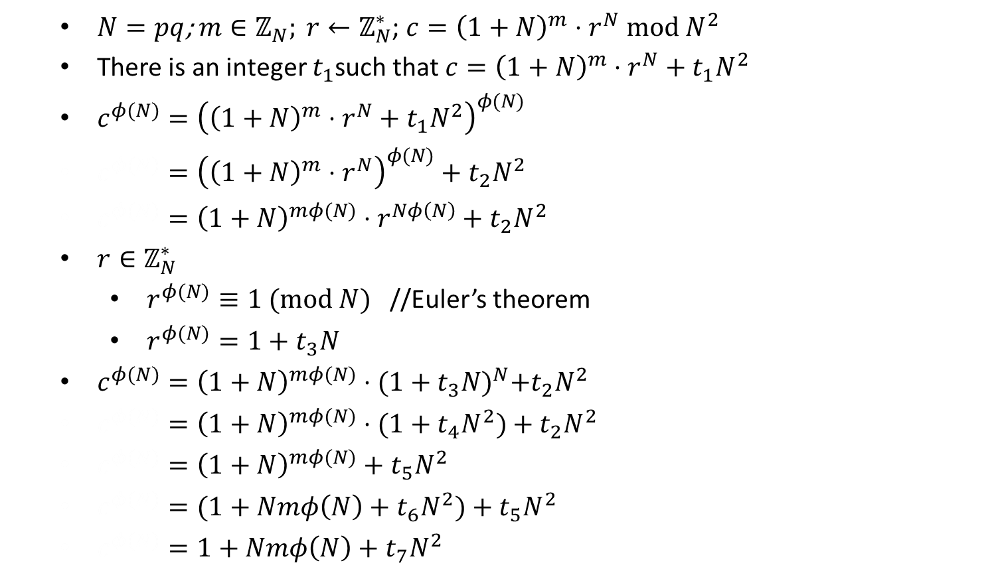
$m=(β⋅γ mod N)$?
$N=pq$;$m∈ℤ_{N}; r←ℤ_{N}^{∗}$; $c={\left(1+N\right)}^{m}⋅r^{N} mod N^{2}$
There is an integer $t_{1}$such that $c={\left(1+N\right)}^{m}⋅r^{N}+{t_{1}N}^{2}$
$c^{φ(N)}={\left({\left(1+N\right)}^{m}⋅r^{N}+{t_{1}N}^{2}\right)}^{φ(N)}$
$c^{φ(N)}={\left({\left(1+N\right)}^{m}⋅r^{N}\right)}^{φ(N)}+t_{2}N^{2}$
$c^{φ(N)}={\left(1+N\right)}^{mφ(N)}⋅r^{Nφ\left(N\right)}+t_{2}N^{2}$
$r∈ℤ_{N}^{∗}$
$r^{φ(N)}≡1 (mod N)$ //Euler’s theorem
$r^{φ(N)}=1+t_{3}N$
$c^{φ(N)}={\left(1+N\right)}^{mφ(N)}⋅{(1+t_{3}N)}^{N}+t_{2}N^{2}$
$c^{φ(N)}={\left(1+N\right)}^{mφ(N)}⋅(1+t_{4}N^{2})+t_{2}N^{2}$
$c^{φ(N)}={\left(1+N\right)}^{mφ(N)}+t_{5}N^{2}$
$c^{φ(N)}=(1+Nmφ\left(N\right)+t_{6}N^{2})+t_{5}N^{2}$
$c^{φ(N)}=1+Nmφ\left(N\right)+t_{7}N^{2}$

Slide 21

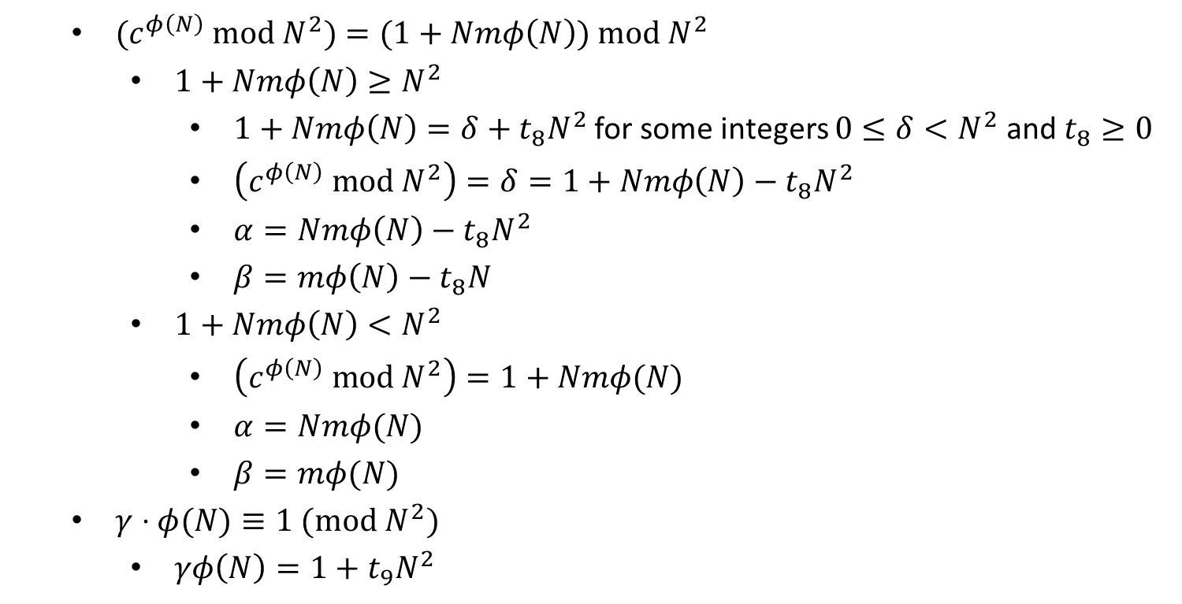
$m=(β⋅γ mod N)$?
$(c^{φ\left(N\right)} mod N^{2})=(1+Nmφ\left(N\right)) mod N^{2}$
$1+Nmφ\left(N\right)≥N^{2}$
$1+Nmφ\left(N\right)=δ+t_{8}N^{2}$ for some integers $0≤δ<N^{2}$ and $t_{8}≥0$
$\left(c^{φ\left(N\right)} mod N^{2}\right)=δ=1+Nmφ\left(N\right)−t_{8}N^{2}$
$α=Nmφ\left(N\right)−t_{8}N^{2}$
$β=mφ\left(N\right)−t_{8}N$
$1+Nmφ\left(N\right)<N^{2}$
$\left(c^{φ\left(N\right)} mod N^{2}\right)=1+Nmφ(N)$
$α=Nmφ(N)$
$β=mφ(N)$
$γ⋅φ(N)≡1 (mod N^{2})$
$γφ\left(N\right)=1+t_{9}N^{2}$

Slide 22

$m=(β⋅γ mod N)$?
$1+Nmφ\left(N\right)≥N^{2}$
$β=mφ\left(N\right)−t_{8}N$
$βγ=\left(mφ\left(N\right)−t_{8}N\right)γ$
$βγ=mφ\left(N\right)γ−t_{8}Nγ$
$βγ=m(1+t_{9}N^{2})−t_{8}Nγ$
$βγ=m+t_{10}N$
$\left(βγ mod N\right)=m$
$1+Nmφ\left(N\right)<N^{2}$
$β=mφ(N)$
$βγ=mφ\left(N\right)γ$
$βγ=m(1+t_{9}N^{2})$
$βγ=m+t_{11}N$
$\left(βγ mod N\right)=m$

Slide 23
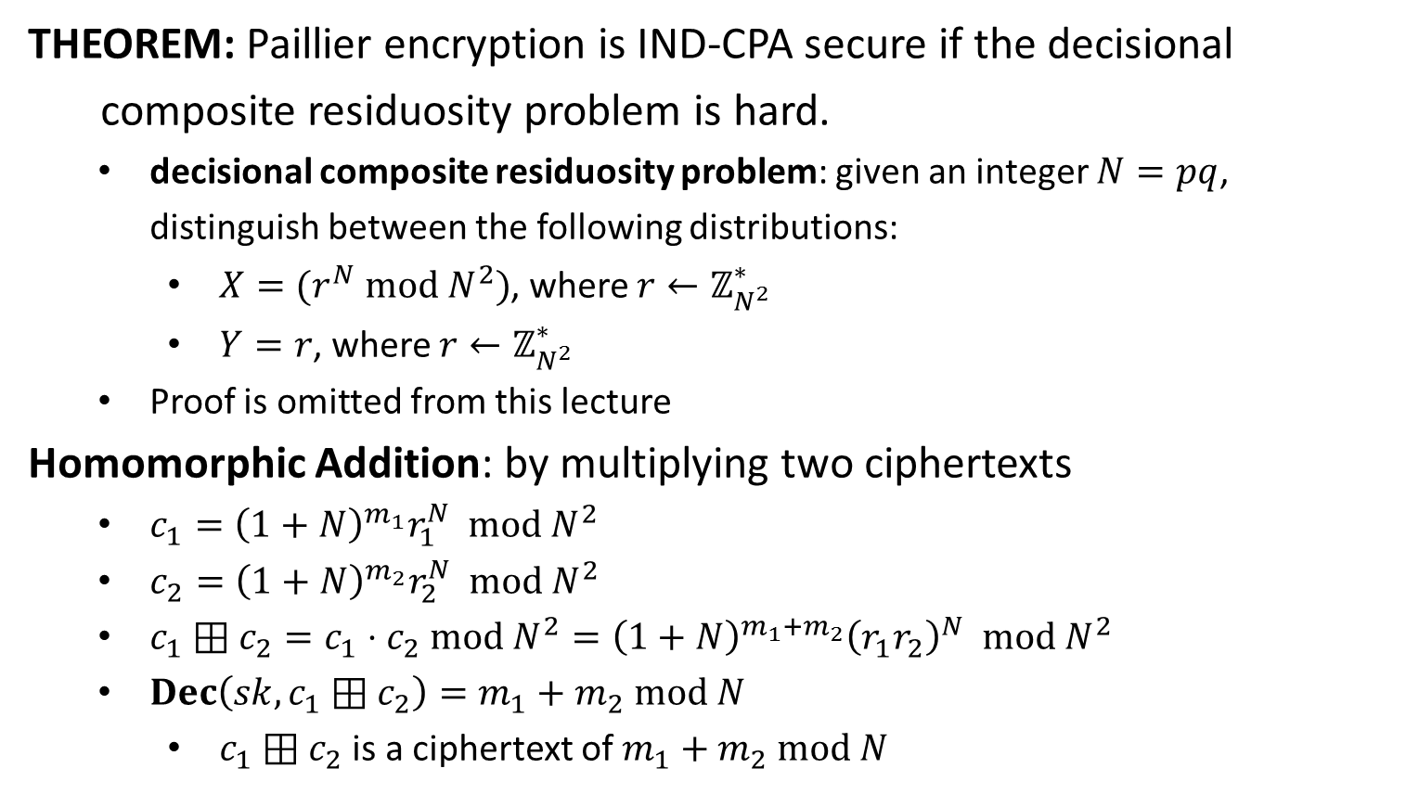
Security & Homomorphic Property
THEOREM: Paillier encryption is IND-CPA secure if the decisional
composite residuosity problem is hard.
decisional composite residuosity problem: given an integer $N=pq$, distinguish between the following distributions:
$X=(r^{N} mod N^{2})$, where $r←ℤ_{N^{2}}^{∗}$
$Y=r$, where $r←ℤ_{N^{2}}^{∗}$
Proof is omitted from this lecture
Homomorphic Addition: by multiplying two ciphertexts
$c_{1}={\left(1+N\right)}^{m_{1}}r_{1}^{N} mod N^{2}$
$c_{2}={\left(1+N\right)}^{m_{2}}r_{2}^{N} mod N^{2}$
$c_{1}⊞c_{2}=c_{1}⋅c_{2} mod N^{2}={\left(1+N\right)}^{m_{1}+m_{2}}{\left(r_{1}r_{2}\right)}^{N} mod N^{2}$
$Dec\left(sk,c_{1}⊞c_{2}\right)=m_{1}+m_{2} mod N$
$c_{1}⊞c_{2}$ is a ciphertext of $m_{1}+m_{2} mod N$

Slide 24





Delegating Computation: Solution
$$x=(x_{1},x_{2},…,x_{n})$$
$$f$$
$$y=f(x)$$
Alice
Bob
$$c_{i}={\left(1+N\right)}^{x_{i}}r_{i}^{N} mod N^{2}$$
$$c_{1},c_{2},…,c_{n}$$
$$f\left(x_{1},x_{2},…,x_{n}\right)=x_{1}+x_{2}+⋯+x_{n}$$
$$c$$
Alice
$$Dec\left(sk,c\right)=x_{1}+x_{2}+⋯+x_{n}$$
Bob
$$c={\left(1+N\right)}^{x_{1}+x_{2}+⋯+x_{n}}{\left(r_{1}r_{2}⋯r_{N}\right)}^{N} mod N^{2}$$

Slide 25
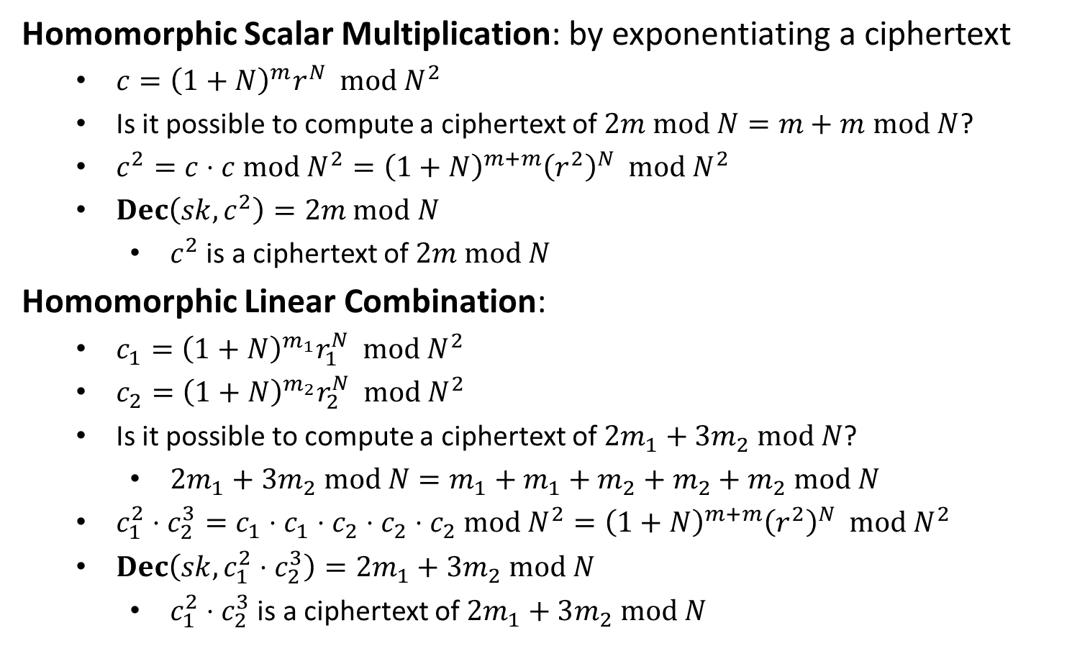
More Homomorphic Property
Homomorphic Scalar Multiplication: by exponentiating a ciphertext
$c={\left(1+N\right)}^{m}r^{N} mod N^{2}$
Is it possible to compute a ciphertext of $2m mod N=m+m$ $mod N$?
$c^{2}=c⋅c mod N^{2}={\left(1+N\right)}^{m+m}{\left(r^{2}\right)}^{N} mod N^{2}$
$Dec\left(sk,c^{2}\right)=2m mod N$
$c^{2}$ is a ciphertext of $2m mod N$
Homomorphic Linear Combination:
$c_{1}={\left(1+N\right)}^{m_{1}}r_{1}^{N} mod N^{2}$
$c_{2}={\left(1+N\right)}^{m_{2}}r_{2}^{N} mod N^{2}$
Is it possible to compute a ciphertext of $2m_{1}+3m_{2} mod N$?
$2m_{1}+3m_{2} mod N=m_{1}+m_{1}+m_{2}+m_{2}+m_{2} mod N$
$c_{1}^{2}⋅c_{2}^{3}=c_{1}⋅c_{1}⋅c_{2}⋅c_{2}⋅c_{2} mod N^{2}={\left(1+N\right)}^{m+m}{\left(r^{2}\right)}^{N} mod N^{2}$
$Dec\left(sk,c_{1}^{2}⋅c_{2}^{3}\right)=2m_{1}+3m_{2} mod N$
$c_{1}^{2}⋅c_{2}^{3}$ is a ciphertext of $2m_{1}+3m_{2} mod N$

